Slide 1
FWD Public Awareness Campaign for the Horn of Africa

Slide 2
Objectives of FWD
Inform
Connect
Engage
  Inform the American people on the crisis in the Horn of Africa
  Leverage USG’s convening power to unite individuals, NGOs, and corporations in responding to the crisis and preventing famine
  Engage the public in new ways to help them become part of the solution

Slide 3
Target Audiences
With television and radio PSA’s running throughout the U.S. and web-banners on major media websites, the campaign reached millions of Americans - a scale never before achieved at USAID.
Identified the following target audiences for more concentrated outreach and engagement.
  Communities of Faith
  Implementing Partners and NGOs
  Corporations
  Youth and University Groups
  Congressional Members and Staffers
  Advocacy Organizations

Slide 4
Messaging
Inform people of the crisis and use it as a hook to talk about the President’ Feed the Future initiative and longer-term food security issues.
Utilize four key info graphics explaining the crisis.
Key Messages:
  There is a massive crisis taking place in the Horn of Africa.
  More than 13.3 million people are affected by the Famine, War and Drought
  But famine is preventable and we know the solutions.
  Through Feed the Future, we are working to make sure these types of disasters never happen again - investing in the short, medium, and long term solutions.
  Making these types of investments is in the interest of the American people - for our National Security and because its the right thing to do.
  You can be apart of the solution: We are the relief.
  It doesn’t take a lot. Just a lot of us.
  Text “Give” to 777444 to Donate $10. A small investment will have a major impact.
  But Do more than Donate. FWD the Facts.

Slide 5
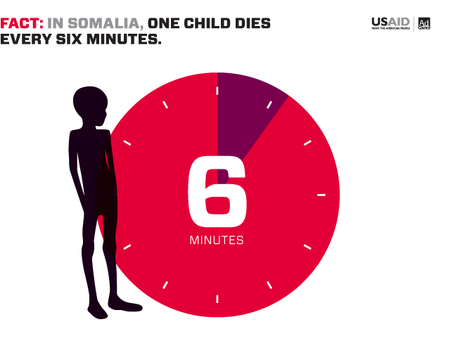
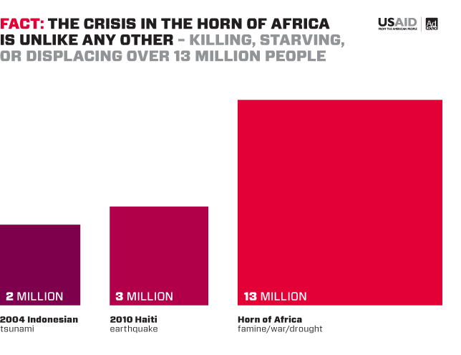
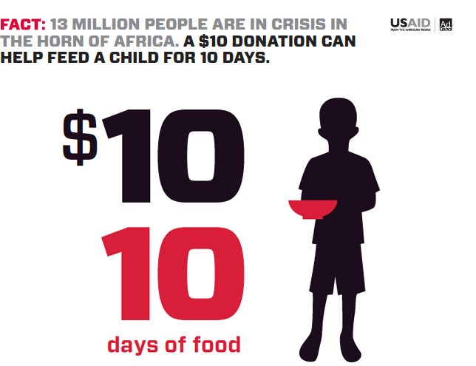
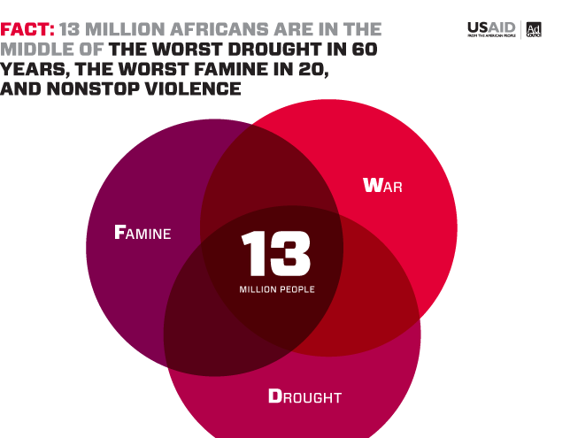
Key Info Graphics

Slide 6
Timeline
September 19: FWD Campaign Launch
October 14: Facebook Buddy Media Tab
October 26: Official PSA Release
November 9: FWD Day
November 9 through December 16: GOOD Competition
December 2 through December 14: MTV Act Auction
December 20: NFL and Anthony Bourdain PSA Release
February 10: Bow Tie Friday

Slide 7
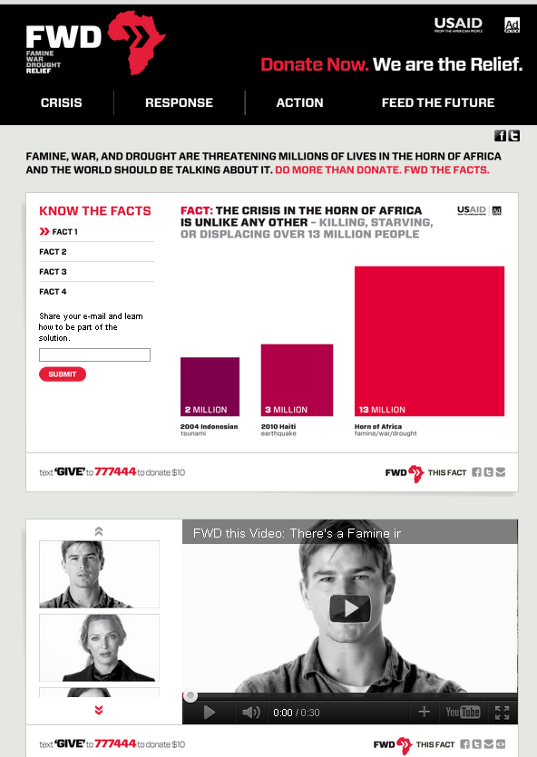
usaid.gov/FWD
Divided into four main sections:
Crisis
Response
Action
Feed the Future
Each page incorporates:
Open Data
Sharable Facts and Information
Opportunities to List Build
Short Narratives Explaining Crisis

Slide 8
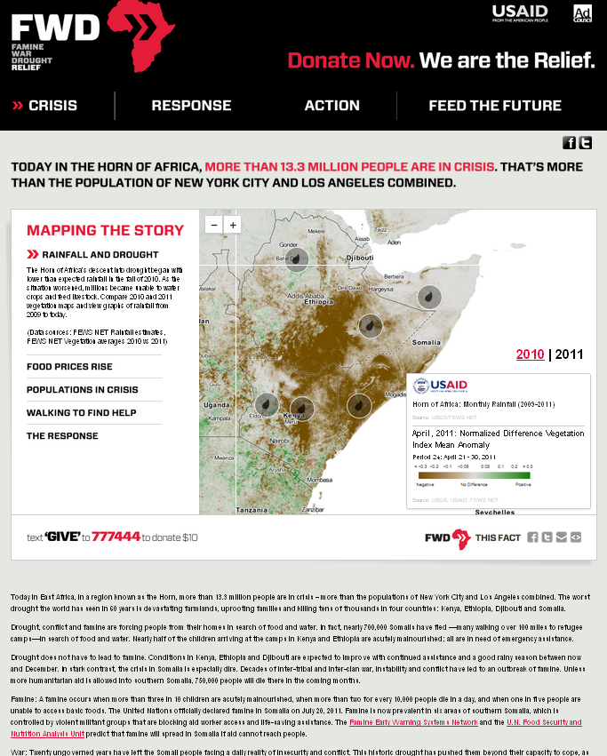
Mapping
Interactive maps tell the story of the crisis
  Utilizing open data from USAID and our partners
  Easily shareable and embeddable in other websites
  Automatically update when new data is available
Notes:
History of Rainfall
Increases in Food Prices
Where Populations are in Crisis
Locations of Displaced People
The Response

Slide 9
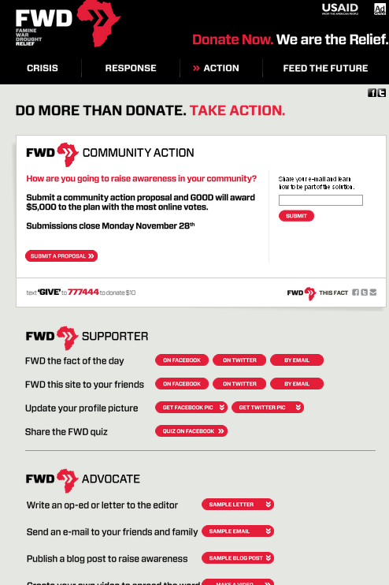
Action
Find new and innovative ways to engage the American people in crisis
  Featured Calls to Action
  Tiered Engagement Opportunities
  Expanded calls to action through partnerships
    GOOD
    MTV
    General Mills
  Toolkits with printable versions of info-graphics, background info and how to donate
  Co-branding options for partner organizations

Slide 10
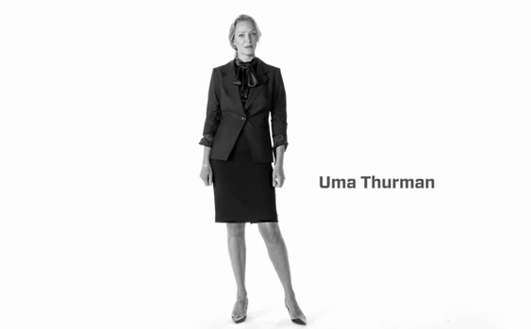
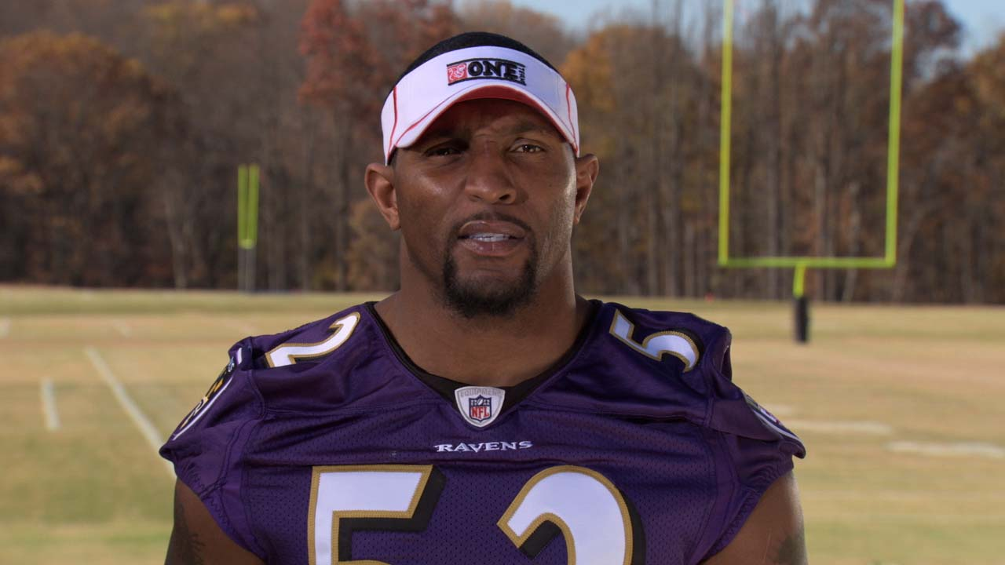
Public Service Announcements
Created a series of TV, Radio, and Web PSAs
TV PSAs distributed to more than 30,000 networks across the U.S.
Round 1– Released Oct 26th
  Josh Hartnet, Geena Davis, Uma Thurman, Chanel Iman, Dr. Jill Biden
Round 2 –Released Dec 20th
  Anthony Bourdain
  NFL Players: Matt Forte (Bears), Jeff Saturday (Colts), Larry Fitzgerald (Cardinals), Ray Lewis (Ravens), Greg Jennings (Green Bay), Josh Freeman (Buccaneers), Maurice Jones-Drew (Jaguars), Lamar Woodley (Pittsburg), Nnamdi Asomugha (Eagles), Asante Samuel (Eagles)

Slide 11
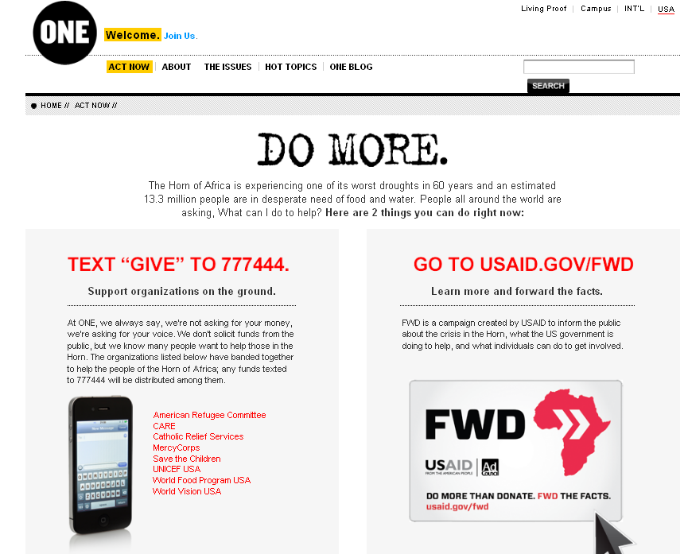
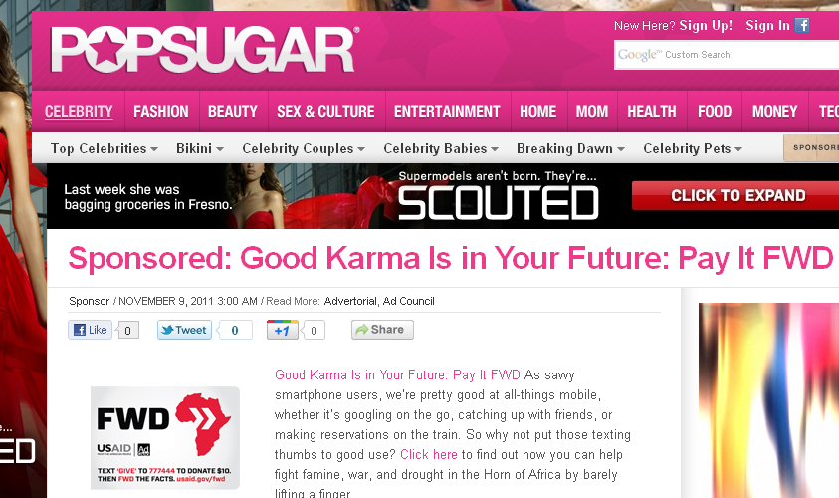
Partnerships
Engaging with a wide-range of organizations to help strengthen and expand the campaign beyond normal networks
Utilizing Ad Council and USAID networks
Partnerships with:
  Faith-Based and Community Organizations
    ex. World Vision and Islamic Relief
  NGO and Implementing Partner Community
  Youth and College Organizations
  Advocacy Organizations
    ex. ONE Campaign
  Corporations
  Media outlets:
    GOOD, MTV, PopSugar,

Slide 12
FWD Day
November 9th
Goal: 13.3 million FWD’s for the 13.3 million people impacted by the crisis in the Horn of Africa.
FWD Day Activities:
  Formally announced on November 8th at Ad Tech Conference to 2,000 marketers
  Provided content and materials to partners, bloggers, faith-based communities
    World Vision and Islamic Relief
  Worked with corporate partners to get their buy-in
    YouTube
    Seamless
  Launched GOOD Competition
  Participated in FWD Day tweet-up from the White House with Jon Carson
  Hosted FWD Day “twiterview” with Monique Coleman from @USAID
  USAID Staff Walk and Reflection
  Make Your Own PSA Tactic Launched (and internal event)

Slide 13
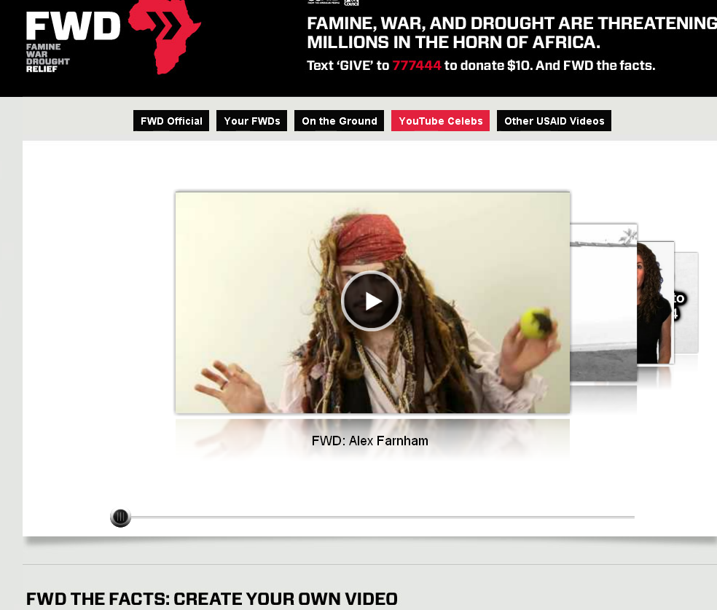
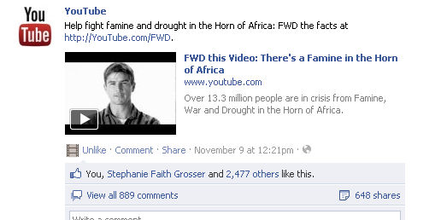
FWD Day - YouTube
Create Your Own PSA Campaign
  Launched “This Moment” Platform, donated by YouTube
  Allowed User Generated Videos to be loaded on to USAID channel
YouTube “Spotlight” on home page
10 YouTube Celebrities made FWD videos
YouTube tweeted and posted on Facebook

Slide 14
FWD Day Success
  Twitter nearly 18 million people were reached generating 51 million impressions
  Nearly 50 million Facebook fans across more than 70 public pages that mentioned the campaign – that doesn’t even include all the private page mentions
  Celebrities from film, music, TV and the arts like Mia Farrow, Eliza Dushku, Mandy Moore, Monique Coleman and Lupe Fiasco, mentioned the campaign to their fans
  More than 40 videos were made garnering over 650,000 video views in just the first few hours of FWD Day,
    Featuring viral video stars like Brittani, Lisa Nova, and the “Chocolate Rain” guy as well as comedy troupes from Barely Political, The Second City and Funny or Die
  More than 30 blog posts with a reach of over 1.1 million people
More than 117 million shares generated

Slide 15
Metrics and Success To Date
FWD Actions Taken:
  More than 150 million FWDs
  40 people around the country made their own FWD PSA
Partnerships Forged:
  13 New Corporate Partnerships
  Consortium of 8 NGOs with the Text-to-Give Campaign
  Host of partnerships created with Advocacy, Faith-Based, and non-traditional organizations.
  Interagency Partnerships – White House, State,
Awareness Raised:
  80,000+ total website hits since launch of campaign
  117 million forwards on FWD Day alone
Digital Traction:
  #FWD achieved trending status on Twitter on FWD Launch and on FWD Day
  More than 30 different bloggers have written about the FWD Campaign
  High profile celebrities, organizations and individuals have tweeted
Contact Lists Built:
  More than 2,600 people have signed up for the FWD e-mail distribution list
  Through the campaign USAID has a list of 700 bloggers
  More than 5,000 new Facebook followers
Other Wins:
  Mapping Platform and usaid.gov/Data
  New and innovative engagement concepts for USG and USAID
  User and Partner Generated Content
Quotes about FWD Campaign
“The FWD campaign is an innovative way to engage citizens into action by making data easily accessible to the public.” – Fabrice Musoni GBI Portal
“The #FWD Campaign website from @USAID might be the coolest site in gov’t. Extremely vital issue.” – Mike Moffo on Twitter

